Slide 1
Thinking Green
Alternative Energy

Slide 2
Green Energy
Definition:

Slide 3
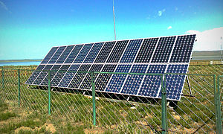
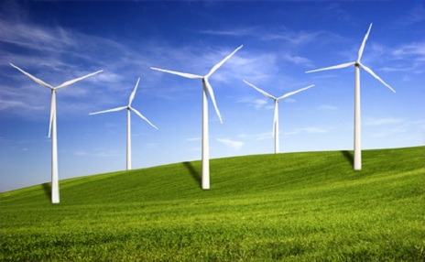
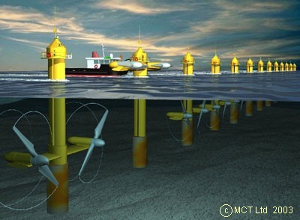
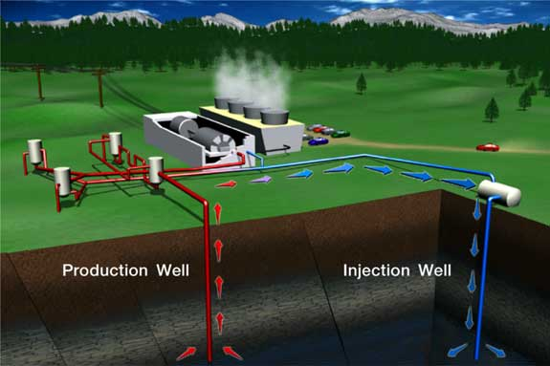
Energy Alternatives

Slide 4
Solar Panels
How do solar panels generate power?

Slide 5
Windmills
How do windmills generate power?

Slide 6
Tidal Power
How does tidal generate power?

Slide 7
Geothermal
How does geothermal generate power?

Slide 8
How does a Hybrid vehicle compare to a traditional car?
 | Hybrid | Traditional
Size
Power Source
Fuel Economy
Effect on the environment

