Slide 1
Settlement - Part 3 Where would you put a city?
On the map on the back of the Settlement Part 2 Notes, put an X where you would put a settlement.
In the space below, provide reasons for why you chose that location for your settlement. Refer to what you can see in the picture.

Slide 2
Factors that determined the location of cities. (p. 132)
1
2
3
4
5
6

Slide 3
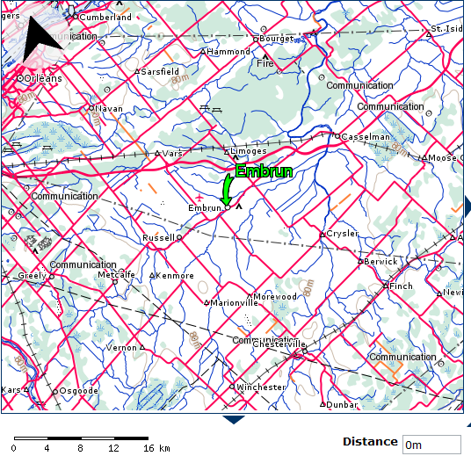
Why does your town exist?
Embrun –
Russell –
Limoges –
Vars –
Marionville –
Morewood –
Casselman –

Slide 4
Communities across Canada
- Hamlet:
- Village:
- Town:
- City:

Slide 5
What can you get or not get where you live?
Higher-order goods –
Low-order goods –

Slide 6
Land use | What is it? | Where is it?
Residential
Commercial
Industrial

Slide 7
City Renewal
Renovation –
Redevelopment –
Land Reclamation –
Diversifying –

Slide 8
GEO Career p. 146
Job Title:
Required Education:
Job Description:

