Slide 1
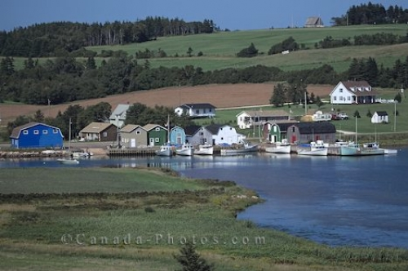
Settlement – Part 3

Slide 2
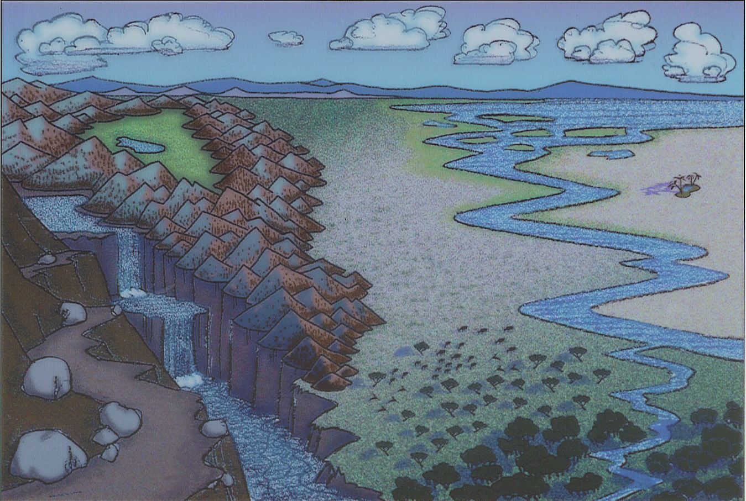
Where would you put a city?

Slide 3
Factors that determined the location of cities. (p. 132)
- natural harbour
- important road intersection
- major highway
- natural resources
- river
- railway

Slide 4
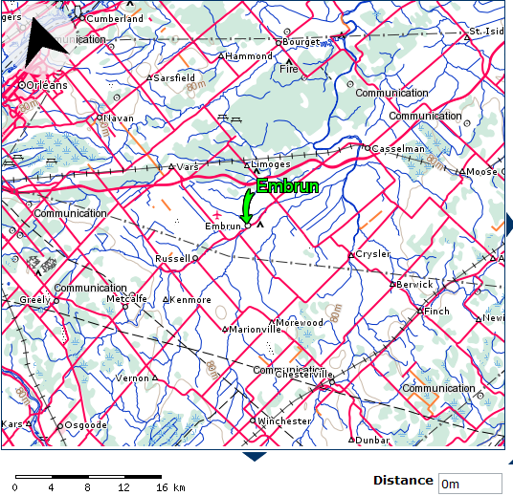
Why does your town exist?
Embrun –
Russell –
Limoges –
Vars –
Marionville –
Morewood –
Casselman –

Slide 5
Communities across Canada
- Hamlet: 7-8 buildings
- Village: 200 – 800 people
- Town: 800 – 10 000 people
- City: 10 000 or more people

Slide 6
What can you get or not get where you live?
Higher-order goods – a good available only in cities. (ex. BMW)
Low-order goods – a good sold everywhere. (ex. Bread)

Slide 7
Land use | What is it? | Where is it?
Residential
Commercial
Industrial

Slide 8
Land use | What is it? | Where is it?
Residential | Houses, condos, apartments, etc… | Suburbs are on the fringes. Apartments/condos in city.
Commercial | Restaurants, stores, gas stations, etc… | easy access locations
Industrial | factories, equipment garages, warehouses, etc… | Access to transportation routes

Slide 9
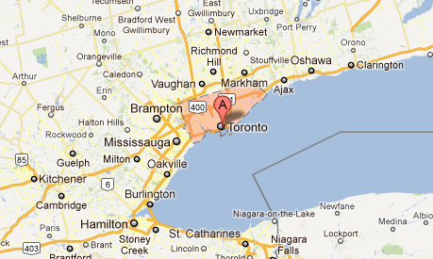
Changing Cities
Many cities have grown so big they now connect to other cities. These are called a MEGALOPOLIS. In Canada, Oshawa to St. Catherines is a megalopolis.

Slide 10
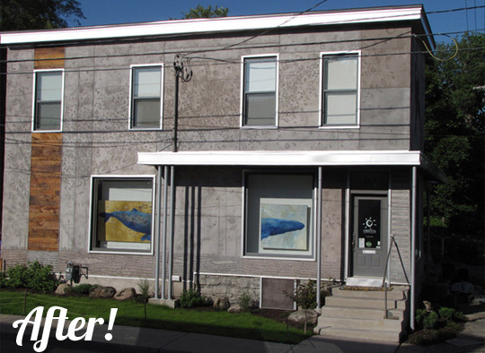
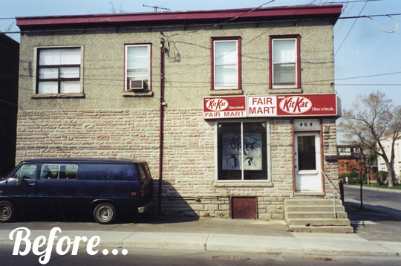
City Renewal
Renovation - a building is redone or changed into something else.

Slide 11
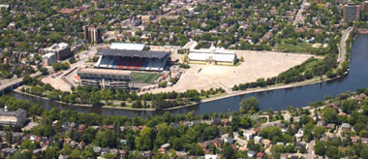
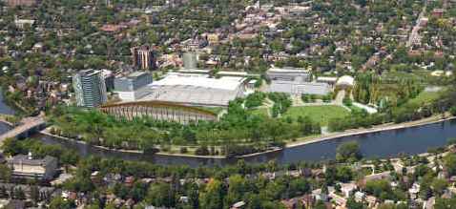
City Renewal
Redevelopment – a building is torn down and a new one is built.

Slide 12
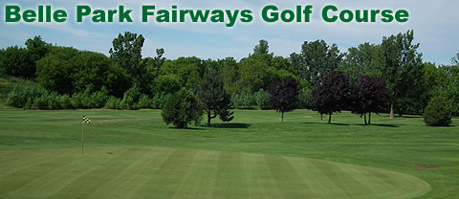
City Renewal
Land Reclamation – clean up of polluted lands and replacing them with parks and wetlands.

Slide 13
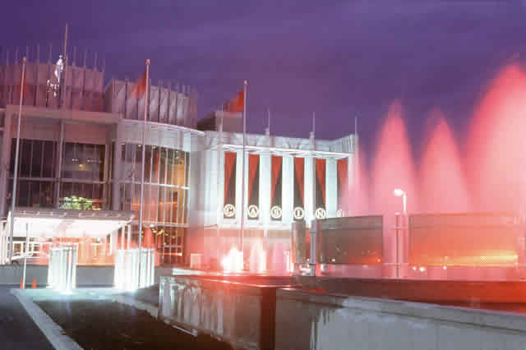
City Renewal
Diversifying – developing new industries.

Slide 14
GEO Career p. 146
Job Title:
Required Education:
Job Description:

