Slide 1
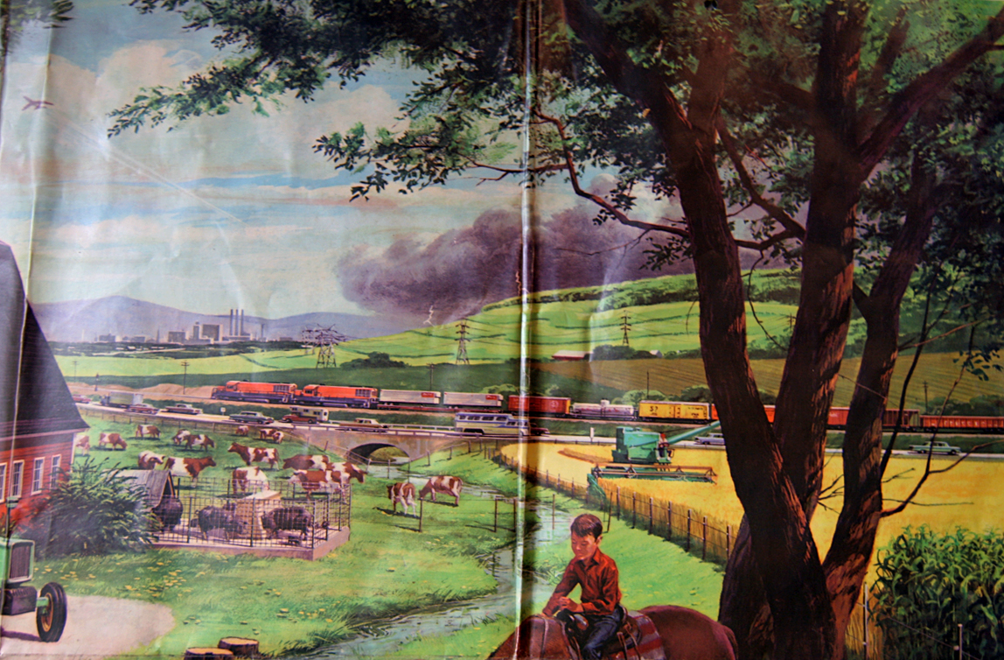
Settlement – Part 2

Slide 2
Rural Urban Migration
Canada started as a country filled with rural people. It has slowly change to become a country filled with Urban people.
Year | Rural % of Population | Urban % of Population
1871 2001
Why?

Slide 3
Immigration and Cities
Why do new immigrants to the country usually settle in large cities?
1
2
3
4
5

Slide 4
Rural vs Urban
Do rural and urban people have the same concerns? Explain.

