Slide 1
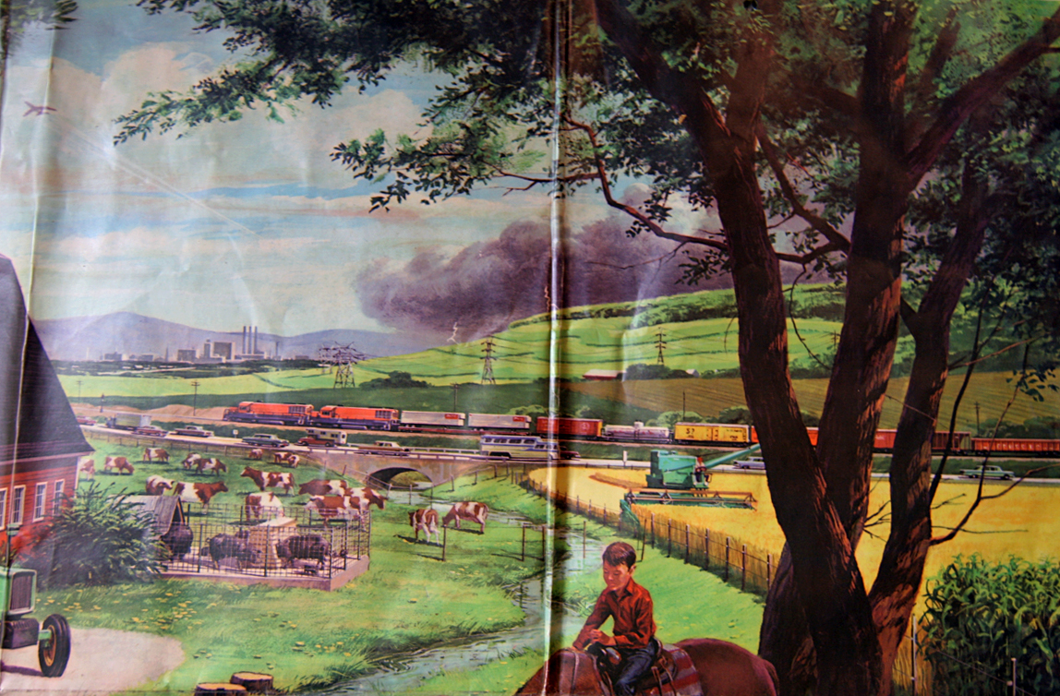
Settlement – Part 2

Slide 2
Video of Canada’s Settlement Trends
http://www.statcan.gc.ca/cgi-bin/af-fdr.cgi?l=eng&k=4965&loc=http://www12.statcan.gc.ca/census-recensement/2006/as-sa/97-550/vignettes/canada.swf

Slide 3
Rural Urban Migration
Canada started as a country filled with rural people. It has slowly change to become a country filled with Urban people.
Year | Rural % of Population | Urban % of Population
1871 2001 | 80 20 | 20 80
Why?

Slide 4
Immigration and Cities
Why do new immigrants to the country usually settle in large cities?
Language
Employment
Family
Culture
Other minorities

Slide 5
Rural vs Urban
Do rural and urban people have the same concerns?

Slide 6
Rural vs Urban
Loss of farmland to the cities. Oak Ridges Moraine p. 127

Slide 7
Rural vs Urban
Play the GeoGame –
The Urban Sprawl Struggle on p. 129 of your textbook

