Slide 1
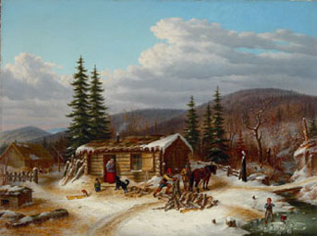
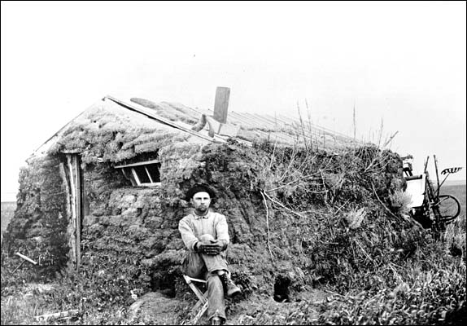
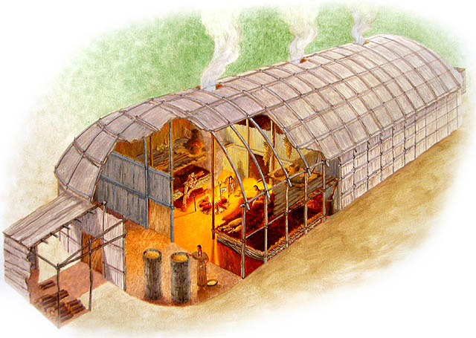
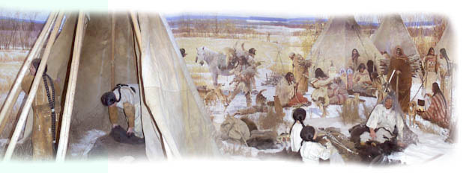
Settlement – Part 1

Slide 2
Settlement Definitions
Rural
Urban
Urbanization
Rural-Urban fringe

Slide 3
Settlement Definitions (con’t)
Land use
Urban Sprawl
Zoning by-law

Slide 4
What was the difference between how the First Nations and Europeans used the land?

Slide 5
In the Beginning
Canada was mainly a _______ country in the early stages of it’s development. The system of rural development used, varied depending on the _______ of Canada.
3 systems Region of Canada
2.
3.

Slide 6
Long -Lot System (p. 121)
This system was used in _______ and began with the ________________ system along the St. Lawrence River. The same system was then used along the many other _____ of Quebec and can even be seen in ____________Ontario along the ___________ River. The river was the major _____________ route so it was advantageous to have water access. Long skinny _____________ sections of land provided all the farmers with ____________ access.

Slide 7
Ontario Township System (p. 122)
___________ system was developed by the British Government. It was a system in which the land was divided into a ______. Each piece of the grid was called a ________ and the pieces tended to be __________. A _____ line was drawn along a natural border (usually ________). __________ were then measured out and were divided by concession _______ (generally east -west). These were then crossed at right angles by side roads. Each concession was then divided into ______ that varied in size.

Slide 8
Quarter Sections
Out _________, they didn’t have as many natural borders to develop a __________. So they use a system similar to the Midwest USA where land was divided into parcels of ____ mile by ___ mile. These were then divided by ____ to create ___ sections. Hence the name __________ section to represent one of these. Roads tend to run at 1 mile intervals to allow access to each part of the quarter section. Most of these are ______ roads. The lines run _______-south and east-______.

