Slide 1
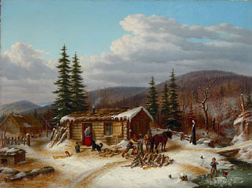
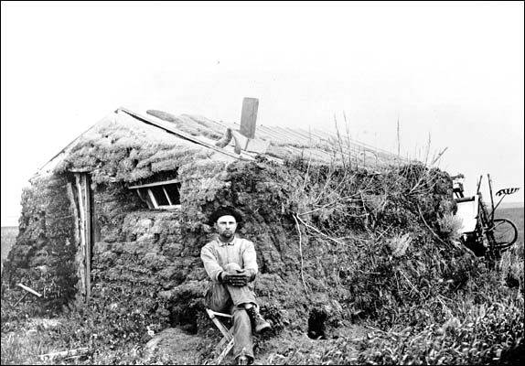
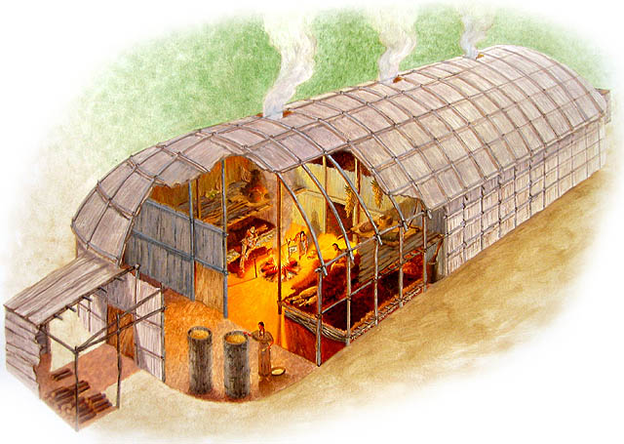
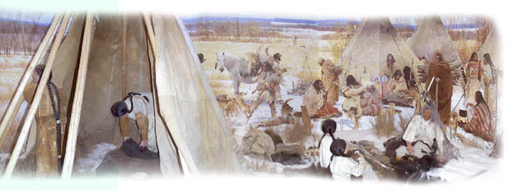
Settlement – Part 1

Slide 2
Settlement Definitions
Rural
-an area that doesn’t include settlements of 1000 people or more.
Urban
- areas including cities and towns that have more than 1000 people.
Urbanization
-a process by which so many people move into rural areas close to existing cities that these areas become urban.
Rural-Urban fringe
- the zone where the city and surrounding countryside meet
Land use
- various ways people use the land
Urban Sprawl
-urban growth that occurs quickly and is sometimes out of control
Zoning by-law
- a law that controls where, how much, or what kind of development takes place

Slide 3
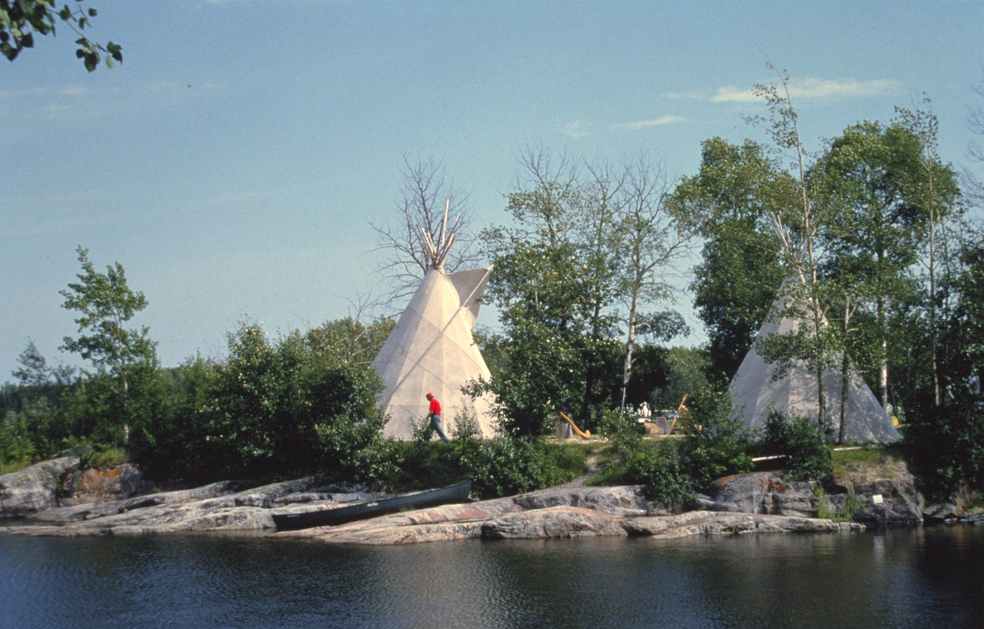
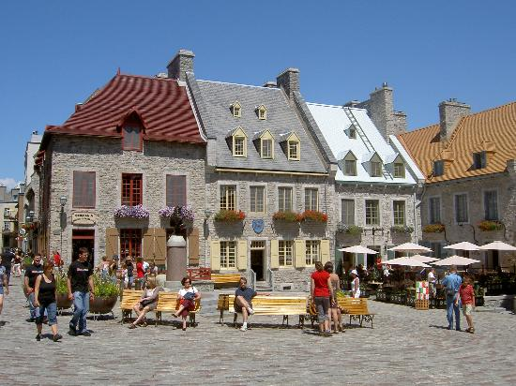
What was the difference between how the First Nations and Europeans used the land?

Slide 4
In the Beginning
Canada was mainly a rural country in the early stages of it’s development. The system of rural development used, varied depending on the region of Canada.
3 systems
Long lots
2. Townships
3. Quarter sections

Slide 5
Long -Lot System (p. 121)
This system was used in Quebec and began with the Seigneury system along the St. Lawrence River. The same system was then used along the many other rivers of Quebec and can even be seen in Eastern Ontario along the Ottawa River. The river was the major transportation route so it was advantageous to have water access. Long skinny rectangular sections of land provided all the farmers with water access.

Slide 6
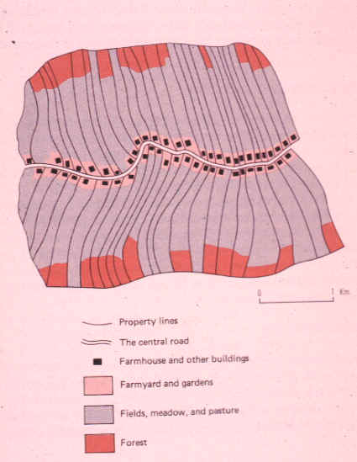

Slide 7
Ontario Township System (p. 122)
Ontario’s system was developed by the British Government. It was a system in which the land was divided into a grid. Each piece of the grid was called a township and the pieces tended to be rectangular. A base line was drawn along a natural border (usually water). Concessions were then measured out and were divided by concession roads (generally east -west). These were then crossed at right angles by side roads. Each concession was then divided into lots that varied in size.

Slide 8
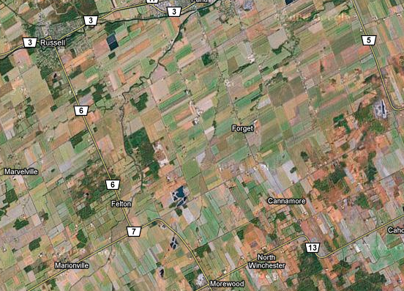

Slide 9
Quarter Sections
Out west, they didn’t have as many natural borders to develop a baseline. So they use a system similar to the Midwest USA where land was divided into parcels of 1 mile by 1 mile. These were then divided in 4 to create 4 sections. Hence the name quarter section to represent one of these. Roads tend to run at 1mile mile intervals to allow access to each part of the quarter section. Most of these are gravel roads. The lines run north-south and east-west.

Slide 10
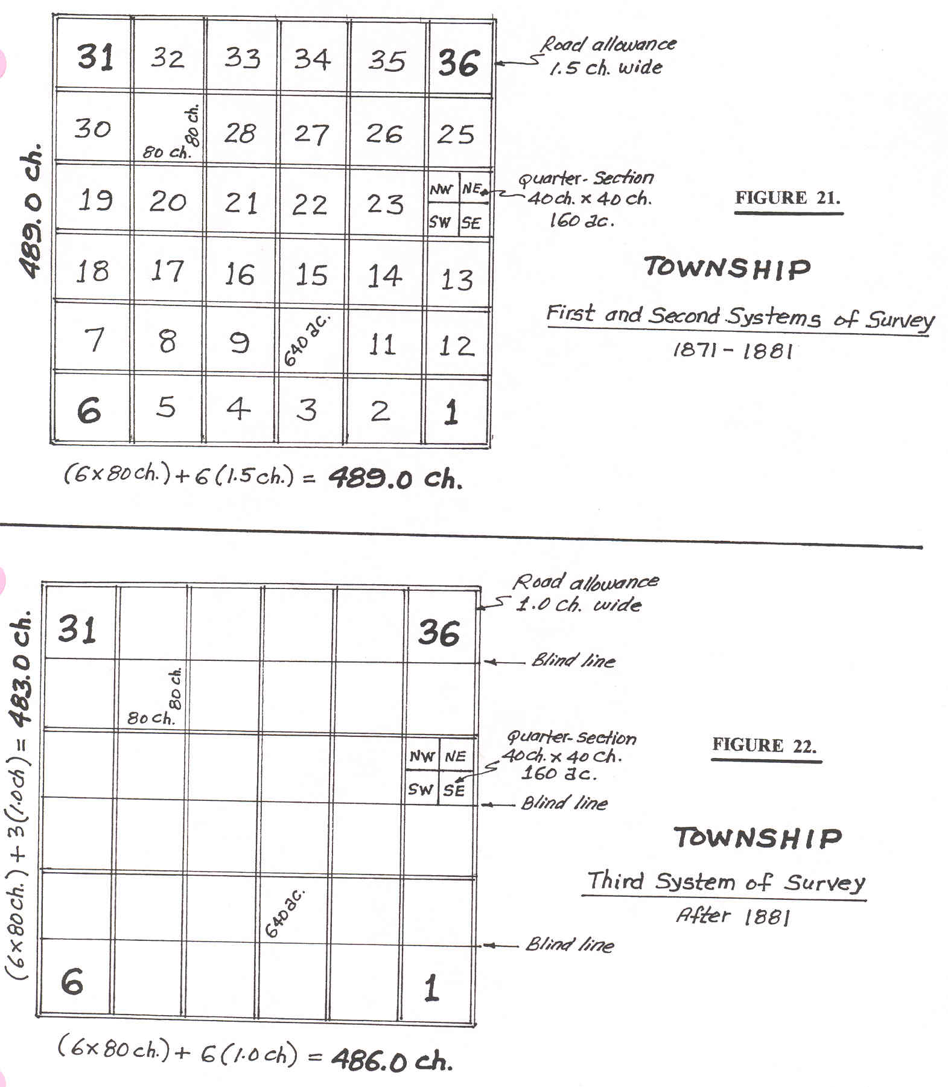

Slide 11
