Slide 1
Energy use in Canada
Canada ranks second in the world in energy use per person.
Why do you think we use so much energy?

Slide 2
Conventional Energy
Definition:

Slide 3
Conventional Energy: Renewable
Definition:

Slide 4
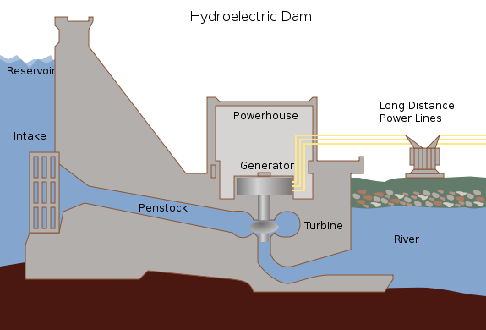
Hydroelectric Power Fill in the blanks below.

Slide 5
Hydroelectric Power p. 225
The Benefits | The Problems

Slide 6
Hydroelectric Power
Would flooding to create a resevoir have a good or bad effect on each of the following?
 | Positive or Negative Effect
Animal habitats
Aboriginal hunters and fishers
Recreational boaters
Farmers on dry land above the river valley
Nearby villages and highways

Slide 7
Conventional Energy: Non Renewable
Definition:

Slide 8
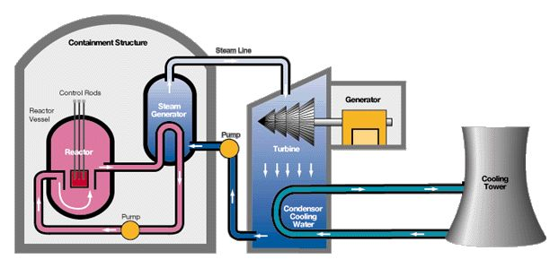
Nuclear Power Plant Fill in the blanks below.

Slide 9
Nuclear Power Plant p. 225
The Benefits | The Problems

Slide 10
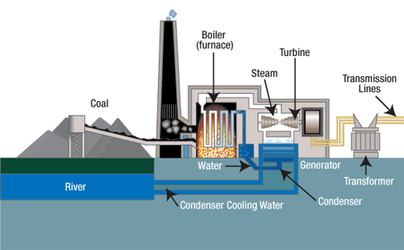
Thermal Electric Power (Coal) Fill in the blanks below.

Slide 11
Thermal Electric Power p. 227 Read this section of the textbook and complete the table below.
The Benefits | The Problems

Slide 12
Common things in Power Generation
Go back and look at your diagrams of how energy is generated. List 4 common things in the table below that are in each diagram. Why are they needed?
4 things | Why are they needed?
1
2
3
4

