Slide 1
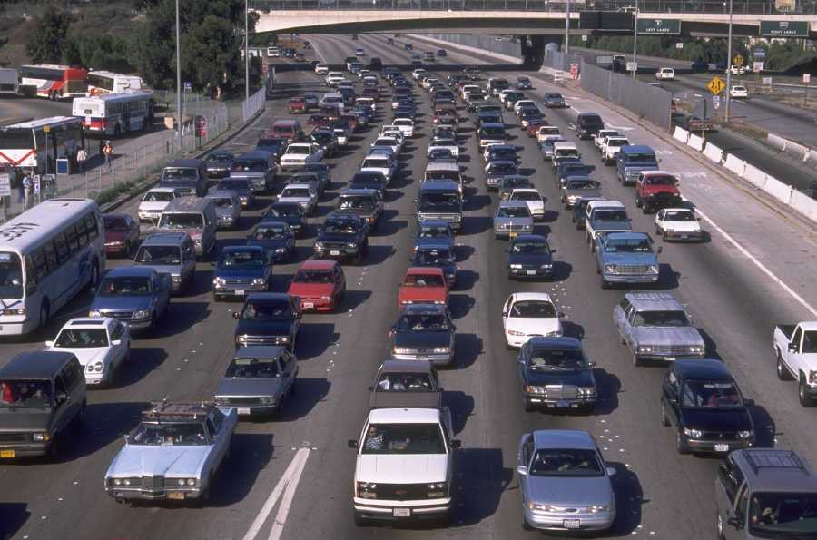
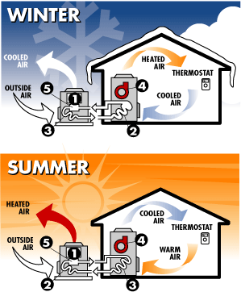
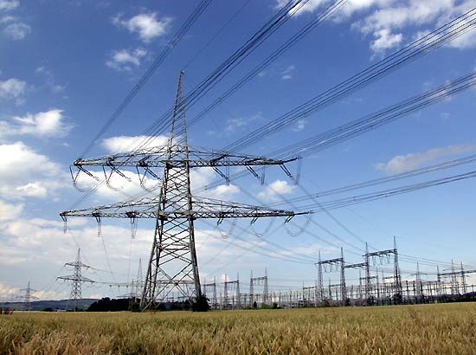
ENERGY

Slide 2
Energy Survey
Complete the Energy Survey.
How did you score on the survey? _______
What is your energy use? ______
Is there anything that you can do to reduce your energy use?

Slide 3
Energy use in Canada
Canada ranks second in the world in energy use per person.
Why do you think we use so much energy?
Long cold winters and Hot, humid summers
Size of the country (travel/transportation)
Our industries use large amounts of energy
High standard of living – own many things
Value comfort and convenience over conservation.

Slide 4
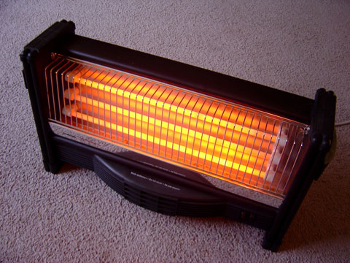
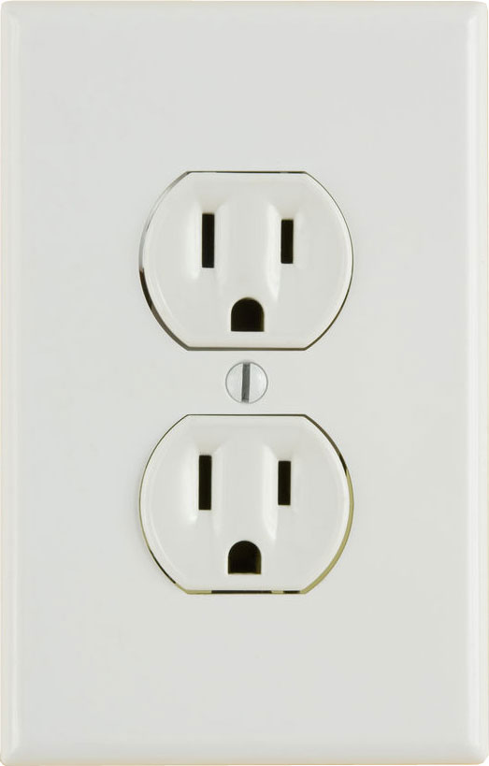
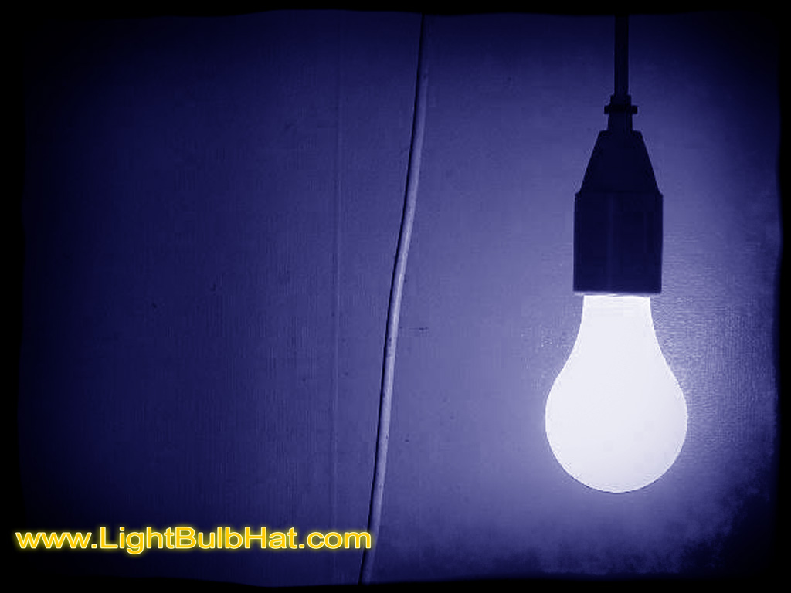
Conventional Energy
Definition: commonly used sources to generate heat, light or power. The sources can be renewable or non renewable.

Slide 5
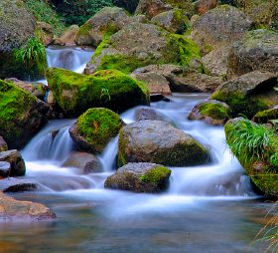
Conventional Energy: Renewable
Definition: an energy supply that can reproduce itself fairly quickly.
Wood
Water

Slide 6
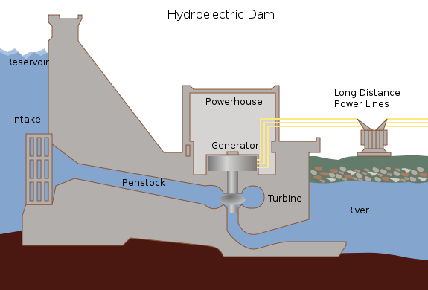
Hydroelectric Power

Slide 7
Hydroelectric Power p. 225
The Benefits | The Problems
Running water is renewable | Often built far from energy customers.
Operating costs are low because no fuel is needed | Because of friction along power lines, the longer the energy travels the lower the voltage
No burning fuel means no air pollution | Very expensive to build and repair
Reservoir provides and agricultural water supply and a site for swimming, boating and fishing | Flooding the reservoir has many negative effects on human communities and animal habitats.

Slide 8
Hydroelectric Power
Would flooding to create a resevoir have a good or bad effect on each of the following?
 | Positive or Negative Effect
Animal habitats
Aboriginal hunters and fishers
Recreational boaters
Farmers on dry land above the river valley
Nearby villages and highways

Slide 9
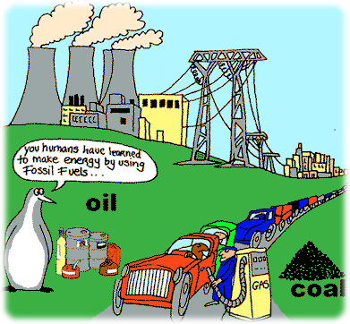
Conventional Energy: Non Renewable
Definition: an energy supply that cannot reproduce itself.
Uranium Fossil fuels

Slide 10
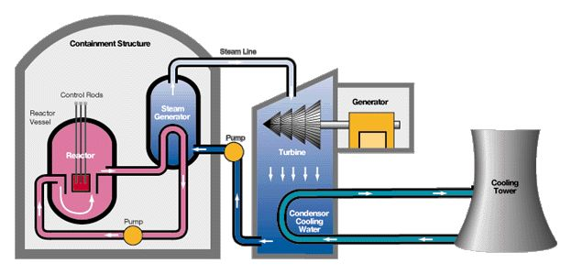
Nuclear Power Plant

Slide 11
Nuclear Power Plant p. 225
The Benefits | The Problems
Canada has a huge supply of uranium fuel from mines in the Canadian Shield | Disposal of nuclear waste
Very little uranium is used in the reactor, so little storage is needed | If reactor fails, radioactivity can kill plant workers and members of the public
Nothing is burned, so there is no air pollution | Very expensive to build and maintain
Can be located closer to electricity users because it does not require a river system | Process is intense so reactors must be rebuilt after a fairly short time

Slide 12
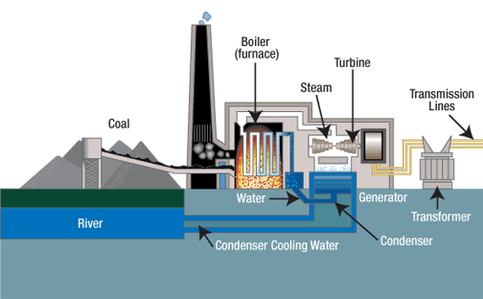
Thermal Electric Power (Coal)

Slide 13
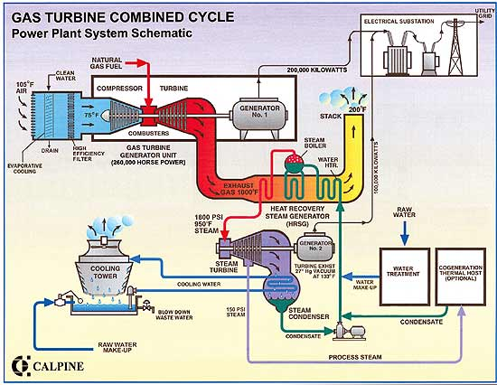
Thermal Electric Power (Gas)

Slide 14
Thermal Electric Power p. 227
The Benefits | The Problems

Slide 15
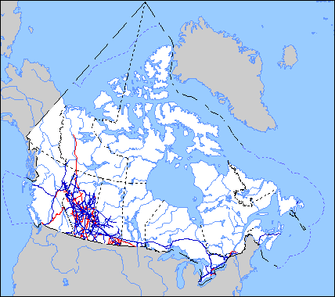
Flows of energy – Oil and Gas

Slide 16
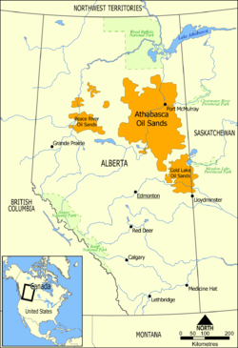
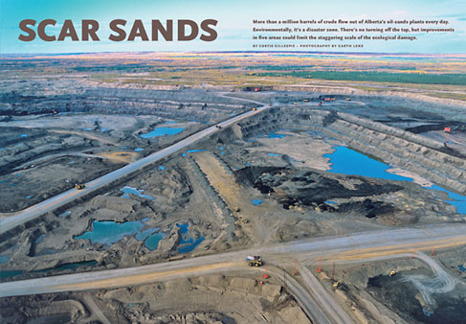
Mega-Project – Oil Sands

Slide 17
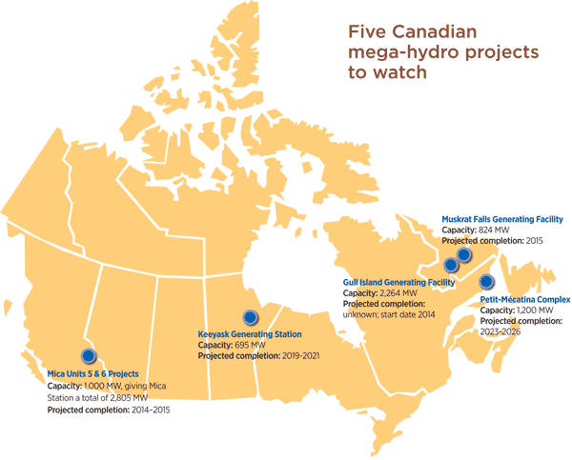
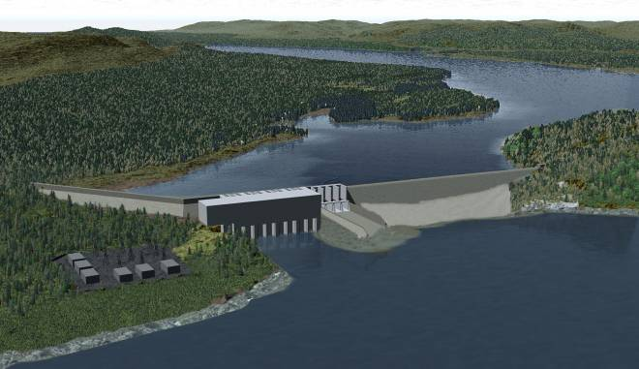
Mega-Project – Hydro

Slide 18
Would you rather live close to a hydro or oil sands Meg-Project? Explain why?

